Slide 1
Saving Education, In-Service Attendance Documents
10-1-2022

Slide 2
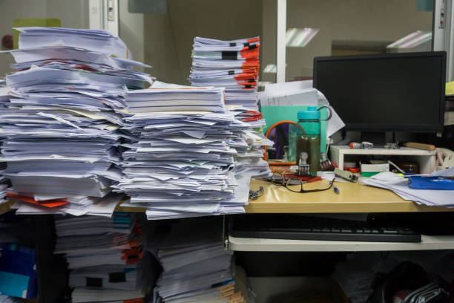
Background
Often in-service rosters are misplaced, lost, or sometimes destroyed.
When proof of education is requested, it can be a tedious process to find the documents requested.

Slide 3
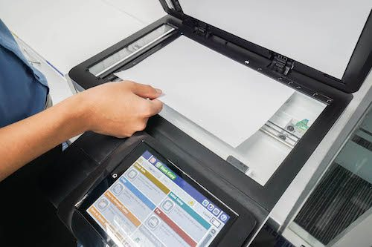
Plan Going Forward
To create a repository for completed in-services for all facilities, a process has been developed to store these documents electronically.
This new process will begin October 1, 2022.
Education/in-service from September can be scanned and emailed if time permits.

Slide 4
Process
Conduct a education/in-service with signed attendance roster(s)
Include the date and title of all subjects covered on the attendance roster.
Following completion of the training, scan and save the attendance rosters and any supporting educational materials
Email the scanned document to EHRsupport@centershealthcare.org
On the subject line of the email provide this description
“Education Record”
In the body of the email include:
Month/year education provided, facility name, and category of education provided (see next slide for categories)
If multiple in-services are conducted, scan and email each one separately

Slide 5
Categories for Education Storage
An EHR team member will save the scanned education documents by facility into one of these categories:
Mandatory education
Mon-mandatory education (just extra education)
Clinical competencies
Plan of Correction education
Staff N95 fit testing records

Slide 6
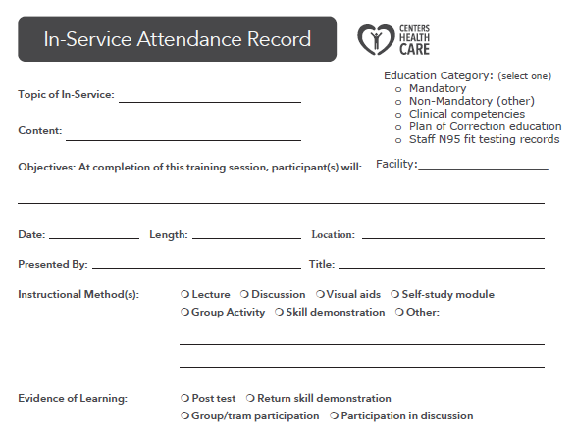
In-Service Attendance Record
Record has been updated to include:
Education Category
Facility Name in addition to the previous location field
Form is available at the following link:
In-Service Attendance Roster Record

Slide 7
Retrieving Documents
If education documents are requested (e.g., by a surveyor):
First, reference your hard copies of these documents stored in your facility
If necessary, contact Bonnie Chustz, Kendra Raymond, or Lorissa Plis to locate these documents for your facility’s saved files
Jacqueline Larson or Darlene Brunner may be available to help if Bonnie Kendra, or Lorissa are not available
These stored documents will be kept an indefinite period of time

